Slide 1
Uva10269
Adventure of Super Mario
Time: 3 seconds

Slide 2

Problem Descriptions(1/4)
After rescuing the beautiful princess, Super Mario needs to find a way home -- with the princess of course :-)
He's very familiar with the 'Super Mario World', so he doesn't need a map, he only needs the best route in order to save time.

Slide 3
Problem Descriptions(2/4)
There are A Villages and B Castles in the world. Villages are numbered 1..A, and Castles are numbered A+1..A+B.
Mario lives in Village 1, and the castle he starts from is numbered A+B.
Also, there are two-way roads connecting them.
Two places are connected by at most one road and a place never has a road connecting to itself.

Slide 4
Problem Descriptions(3/4)
Mario has already measured the length of every road, but they don't want to walk all the time, since he walks one unit time for one unit distance(how slow!).
Luckily, in the Castle where he saved the princess, Mario found a magic boot.
If he wears it, he can super-run from one place to another IN NO TIME. (Don't worry about the princess, Mario has found a way to take her with him when super-running, but he wouldn't tell you :-P)

Slide 5
Problem Descriptions(4/4)
Since there are traps in the Castles, Mario NEVER super-runs through a Castle.
He always stops when there is a castle on the way.
Also, he starts/stops super-runnings ONLY at Villages or Castles.
Unfortunately, the magic boot is too old, so he cannot use it to cover more than L kilometers at a time, and he cannot use more than K times in total. When he comes back home, he can have it repaired and make it usable again.

Slide 6
Input
The first line in the input contains a single integer T, indicating the number of test cases. (1<=T<=100)
Each test case begins with five integers:
A, B, M, L, K
A:the number of Villages
B:the number of Castles (1<=A,B<=50)
M:the number of roads
L:the maximal distance that can be covered at a time (1<=L<=500)
K: the number of times the boot can be used. (0<=K<=10)
The next M lines each contains three integers X_{i}, Y_{i}, L_{i}.
That means there is a road connecting place X_{i} and Y_{i}.
The distance is L_{i}, so the walk time is also L_{i}. (1<=L_{i}<=100)

Slide 7
Output
For each test case in the input print a line containing a single integer indicating the minimal time needed to go home with the beautiful princess. It's guaranteed that Super Mario can always go home.

Slide 8
Sample Input / Output
Input
1 4 2 6 9 1 4 6 1 5 6 10 4 5 5 3 5 4 2 3 4 1 2 3
Output
9
number of test case
A
B
M
L
K
4 Villages
2 Castles
6 Roads
1 boot 1 time and distance 9
4
1
3
5
6 Roads
3
4
10
5
2
4
6
1

Slide 9
Sample Input / Output
Input
1 4 2 6 9 1 4 6 1 5 6 10 4 5 5 3 5 4 2 3 4 1 2 3
Output
9
number of test case
A
B
M
L
K
4 Villages
2 Castles
6 Roads
1 boot 1 time and distance 9
4
1
3
5
6 Roads
3
4
10
5
2
4
6
1

Slide 10
Dynamic Programming
d[i][k]: Store minimum cost of reaching point i with using boot k times.
k
using boot k times
minimum cost
of reaching point i
i

Slide 11
Recurrence Formula (1/2)
Case1:
For any point i, find a point x
if dp[i][k]>dp[x][k]+M[x][i]
then dp[i][k]=dp[x][k]+M[x][i]
Walk from x to i
k times
k times
>
M[x][i]
x
d[x][k]
i
i
dp[i][k]
dp[i][k]

Slide 12
Recurrence Formula(2/2)
Case2:
For any point i, find a point x
if (M[x][i]<=L) && (k<K) && (dp[i][k+1]>dp[x][k])
then dp[i][k+1]=dp[x][k]
Jump from x to i
k-1 times
>
K+1 times
jump
M[x][i]<=L
x
d[x][k]
i
i
d[i][k+1]
d[i][k+1]

Slide 13
Floyd Warshall Algorithm
Find the shortest path from any source to any destination.
Modifications:
Castle A+1~A+B cannot be the middle point of the shortest path.

Slide 14
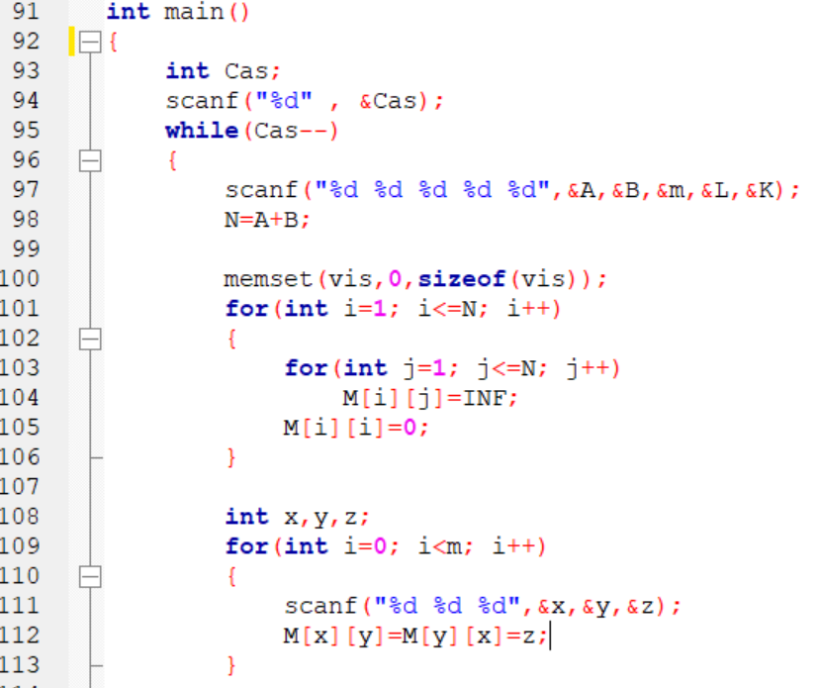

Slide 15
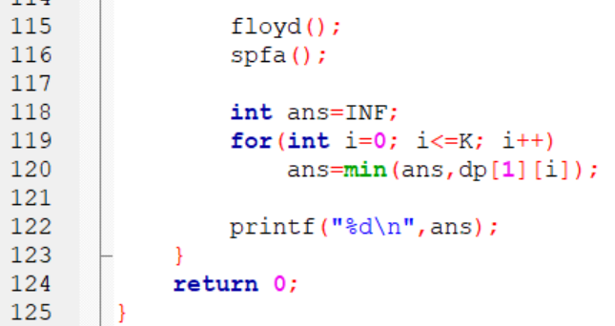

Slide 16
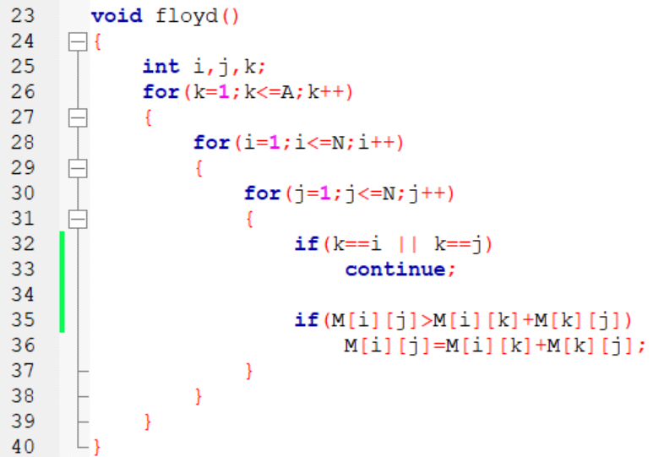

Slide 17
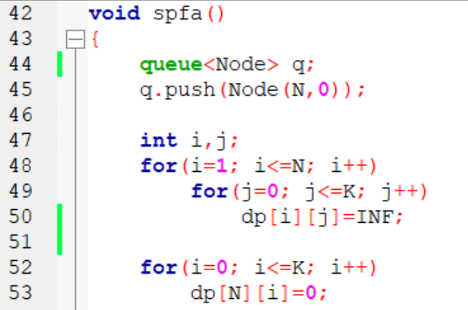

Slide 18
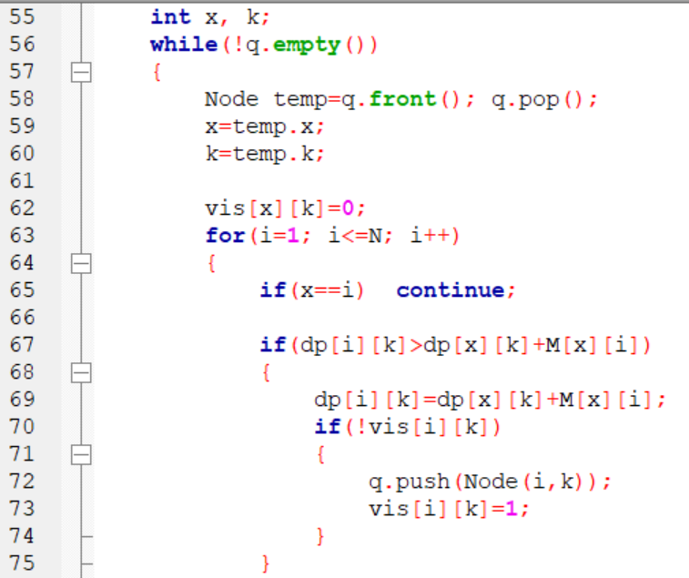

Slide 19
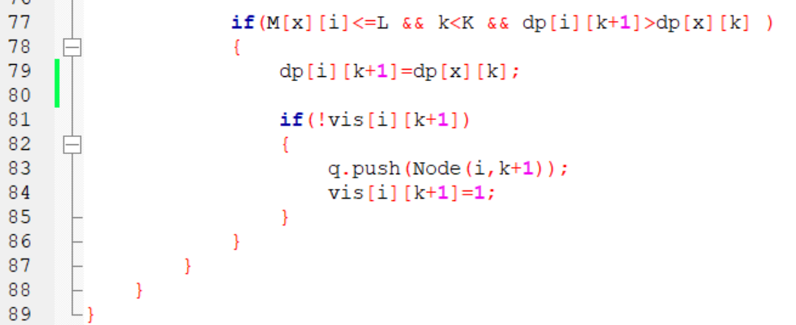

Slide 20
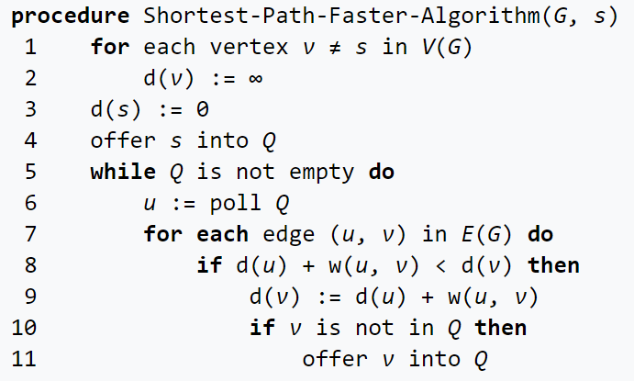
Shortest Path Fast Algorithm SPFA

Slide 21
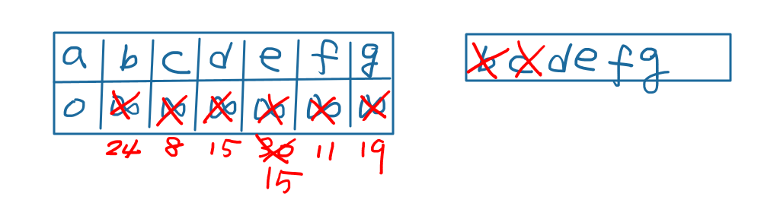
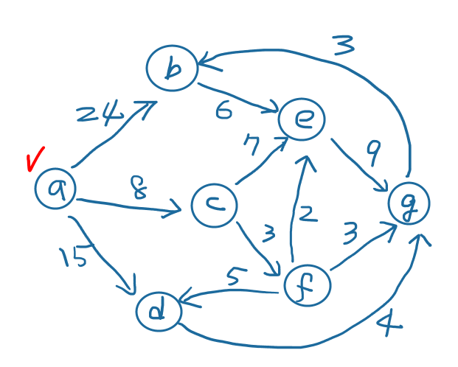
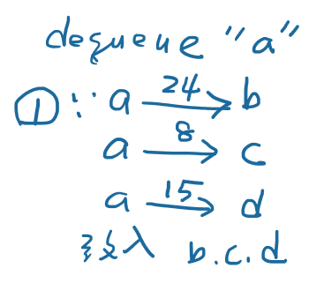
Example

Slide 22
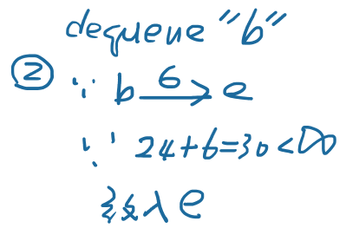
Example

Slide 23
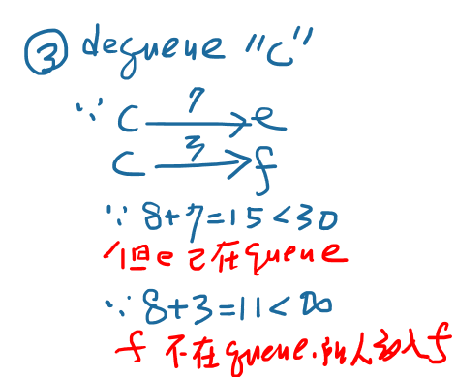
Example

Slide 24
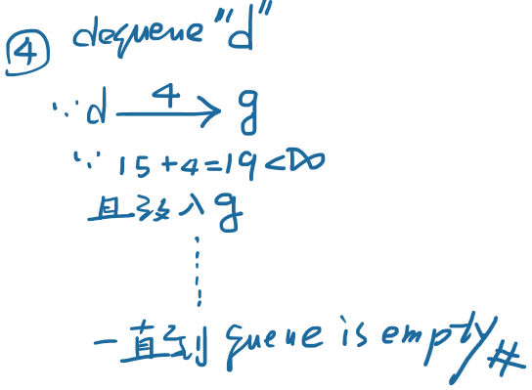
Example

Slide 25
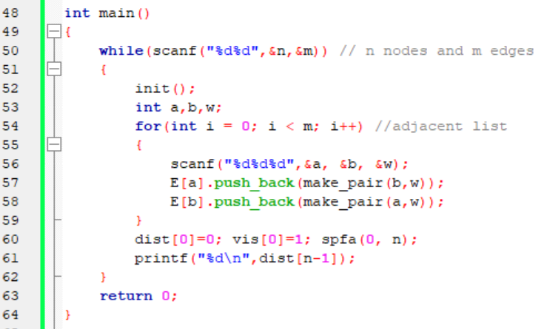
Shortest Path Fast Algorithm SPFA

Slide 26
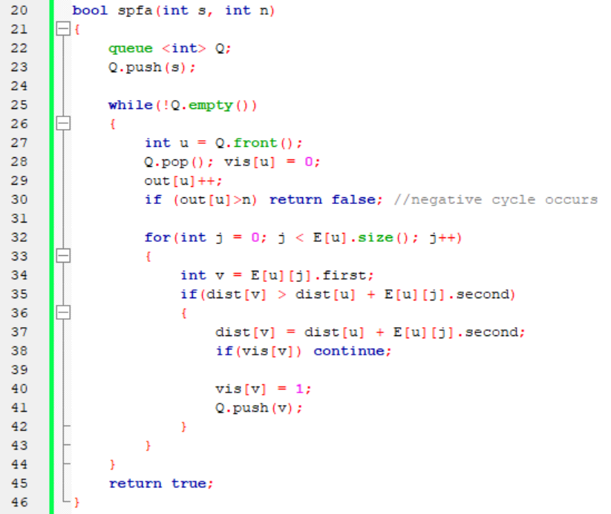
Shortest Path Fast Algorithm SPFA

Slide 27
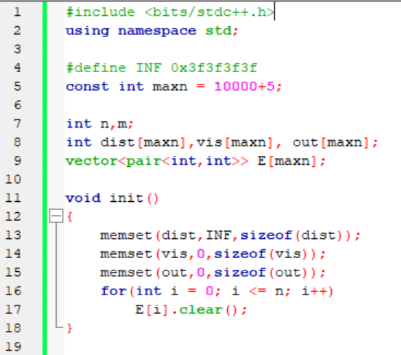
Shortest Path Fast Algorithm SPFA

